Slide 1

It’s a Live(View) Discover the Elixir of Life With a Virtual Pet
Create a pet
Brian Meeker
Sr. Software Engineer at Online Rewards
Starting at 11:00
https://that-pet.fly.dev
Notes:
While we're waiting, feel free to sign up and create your own virtual pet in the app I built for this talk, LivePet (or THAT Pet if you prefer). Follow the link or QR code on the screen. I apologize for requiring signup, but I promise I'm not mining your personal information. I'm not going to email any of you after the conference.
Welcome everybody! This is my first time at THAT Conference. I'm so glad that you chose to spend your first session of the day with me. If this talk isn’t working for you, I will not at all be offended if you vote with your feet. It costs money and time to come to a conference like this. Some of you have traveled a long ways. If the session isn’t working for you, go find one that does.
By show of hands, who here has any experience with Functional programming in general? What about Elixir? What about LiveView?
And what about other frameworks that let you create modern web apps without JavaScript? Blazor? Hotwire? Livewire?
With that being said, let's dive in!

Slide 2

Notes:
Special thanks to all the sponsors of THAT Conference. Conferences are expensive and your ticket doesn’t even come close to covering the cost of the conference. Sponsors cover a lot of those costs, so be nice to them and say hi.
And thank a volunteer too while you’re at it. They make this thing happen.

Slide 3

Notes:
You’re going to be very tired of seeing this slide by Thursday, but it’s never to soon to start thinking about next year. THAT Conference 2024 will be July 29th – Aug 1st here in Wisconsin.

Slide 4


Brian Meeker
Website
https://brianmeeker.me
GitHub
@CuriousCurmudgeon
Mastodon
@brianmeeker@hachyderm.io
Notes:
My name is Brian Meeker. I'm a long-time mostly C# dev who's also worked with a variety of other languages, like JavaScript, Ruby, and Perl. I started dabbling with Elixir in 2017, but didn't take the plunge full-time until this past October when I joined Online Rewards.
Online Rewards is based out of Cincinnati and provides reward and incentive programs to our customers. We send out a LOT of gift cards. Other things too, but a LOT of gift cards.
I've worked 100% remote since 2012 from Indiana, so, welcome to all of those who were forced into my world a few years ago.
I used to be on Twitter, but you can find me these days on Mastodon and GitHub. All the code for the pet app I’ll be showing today is available on GitHub. The repo is called live_pet and it will be pinned to the top of my account.

Slide 5

Agenda
Elixir Crash Course
Processes & Concurrency
LiveViews
Events
Real-Time Updates
Components
Presence
PubSub
Notes:
With that out of the way, let's talk about what's in scope for today. We have 60 minutes, so you're not going to walk out of here as an expert in Elixir and LiveView. I want to give you a taste of what is possible.
We're going to start with a brief overview of the language itself so you can better follow the code examples. Then we're going to talk about the process model Elixir uses.
After that, we're going to switch over to LiveView. We'll talk about how it builds on top of the Elixir process model. Then, through a series of demos we’re going to build up most of the features you see in THAT Pet today, all without writing a single line of JavaScript.
So, that's a lot of things to cover in an hour. We're not going to cover anything about testing. We're not going to talk about Erlang at all, which is the original language that runs on the BEAM. We're not going to talk about other JavaScript frameworks. I've used Vue and Angular, but we're not going to do much, if any, comparison with those frameworks. If you’re interested in those comparisons, I would love to talk to you afterwards or over the next few days.

Slide 6
Goal
A broad understanding of Elixir and how you can use LiveView to write SPAs with little-to-no JavaScript.
Notes:
Some of you attended workshops yesterday. Many saw the opening keynote this morning. This is the first session of many you’ll attend over the next three days. You’re going to be bombarded with lots of things that you are excited about. That’s one of the great things about conferences.
My goal is simply this. I want you to leave this room today excited enough to try Elixir and LiveView that you actually sit down and give it a shot. That could be right after this session. It could be this weekend. It could be next month or next year.
And, hey, if this isn’t the session that excites you the most, I hope you take the time to dive more deeply into whatever new thing strikes a chord with you this week. Don’t leave THAT Conference with the intent of one day diving deeper into something. As you leave the conference, pick which one thing you want to learn more about and go for it. And if that thing is Elixir and LiveView, awesome.

Slide 7
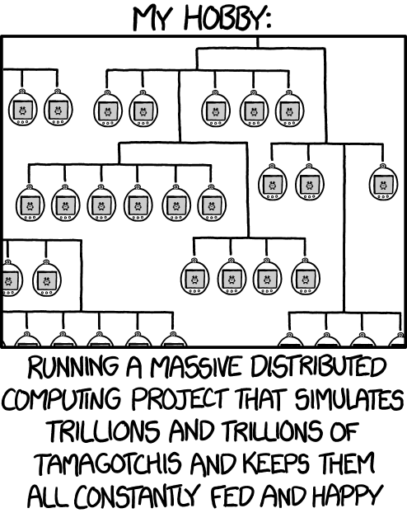
https://xkcd.com/1546/
Notes:
Who has seen this XKCD?
The idea of building some sort of fun simulation project has been percolating in the back of my head for years. And I think Elixir and LiveView are a wonderful vehicle for exactly this problem of virtual pets

Slide 8

simulate all the pets
give a crash course in Elixir
Notes:
The problem of course is that I’m speaking at a conference where I can’t expect anybody in my audience to know anything about Elixir, so…

Slide 9










Notes:
Elixir is a functional, dynamic, immutable language with robust support for pattern matching and macros. And, very importantly for my desire to simulate an absurd number of virtual pets, it has amazing concurrency support.

Slide 10

https://survey.stackoverflow.co/2023
Notes:
Who here completed the StackOverflow 2023 community survey? Who has looked at the results yet?
This chart is something new in this years survey. For each line, the blue dot on the left marks how many people want to use a technology. They label that as how desired it is. The red dot on the right is how admired it is. This measures how many people who have used the tech want to use it again. They’re using this to measure hype vs. reality. Wide distances mean not many people are using it, but those who do really want to use it more.
We can see that Rust’s buzz is pretty deserved. It was the most admired language with over 80% of Rust users wanting to use it again. In second though is Elixir. It’s usage is much lower, so it has the widest range between desired and admired. The community is smaller, but really, really passionate about it. That matches my experience as well.

Slide 11

The Elixir programming language wraps functional programming with immutable state and an actor-based approach to concurrency in a tidy, modern syntax. And it runs on the industrial strength, high performance, distributed Erlang VM
- Dave Thomas - Programming Elixir
Notes:
For historical context, Elixir runs on the same virtual machine as Erlang, commonly referred to as BEAM or “the BEAM”.
Erlang came out of Ericsson in the 1980's to control telephone switching systems. It was designed to be
Distributed
Fault-tolerant
Soft real-time (any hardware folks in the room should be nodding along that I called out "soft" real time, not hard)
Highly available
Hot swappable. You can deploy new code without taking down the system.
Erlang had been chugging along for decades before José Valim started working on Elixir in 2012 as an alternative language to run on the BEAM.
Let’s dive into a very rapid overview of the language. This is far from comprehensive. The goal is to get you comfortable seeing code. If you don’t fully understand, that’s fine.

Slide 12
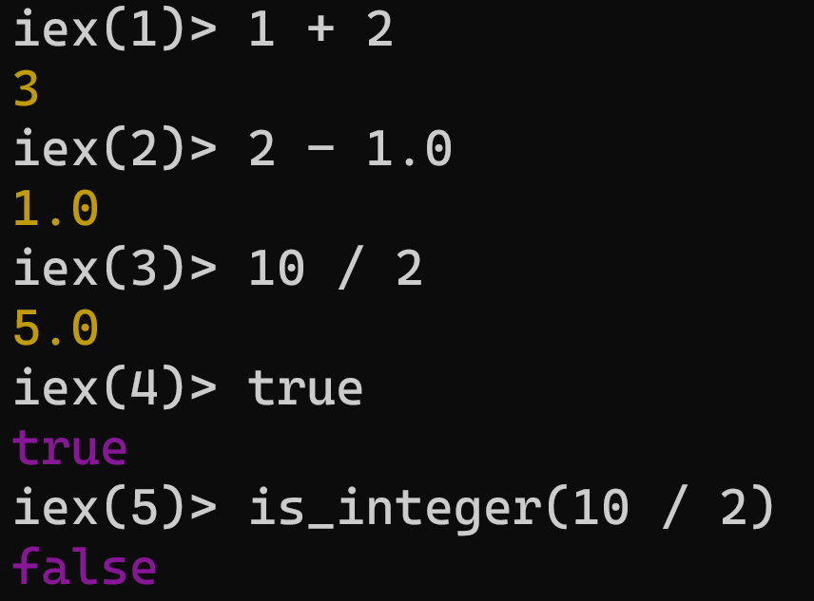
Integers, Floats, and Booleans
Notes:
The examples you’re going to see here are in Interactive Elixir, “IEx”. This is Elixir’s REPL (read-eval-print-loop) tool.
Integers, floats, and booleans work just as you expect.

Slide 13
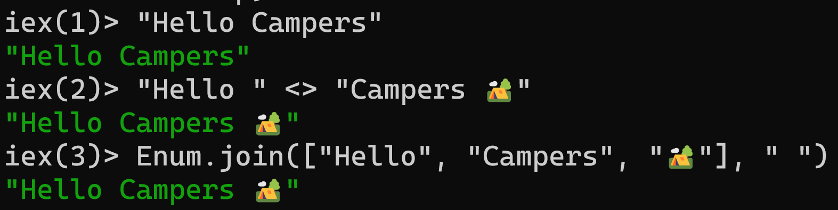
Strings
Notes:
Strings are double quoted and encoded as UTF-8. Concatenation is with less than, greater than.

Slide 14
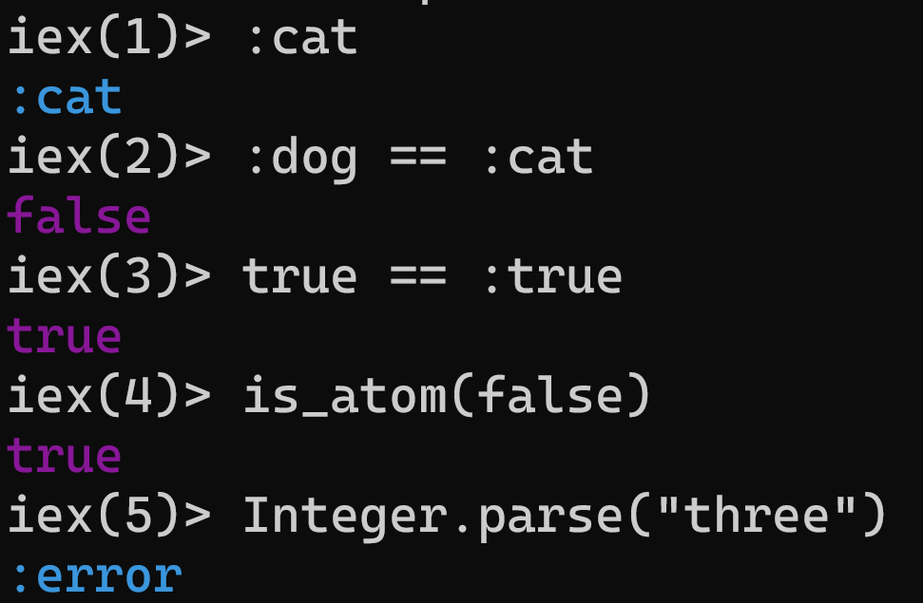
Atoms
Notes:
Atoms are functionally equivalent to symbols in Ruby. They are constants whose value is its own name. They always start with a `:`. You will see them all over code examples later, especially as the status of an operation, such as :ok and :error
True and false are also atoms.

Slide 15
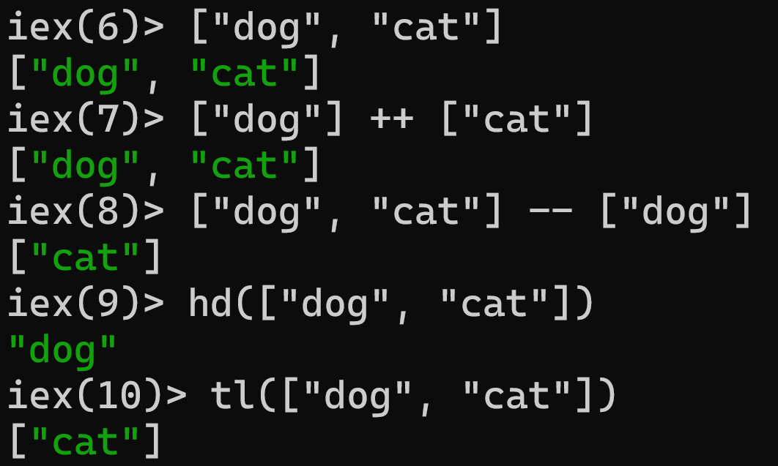
Lists
Notes:
Lists are linked lists. Do not make the mistake of thinking of them as arrays. They're easy to traverse linearly, but expensive to get a random element out of.
Values can be any type. In practice, your lists will usually be homogenous, but not always. You can concatenate and subtract them with ++ and --.
Since they are linked lists, a lot of operations are based around getting what is called the head and tail. The head is the first element in the list and the tail is the rest of the list. You can see the hd and tl operations here.

Slide 16
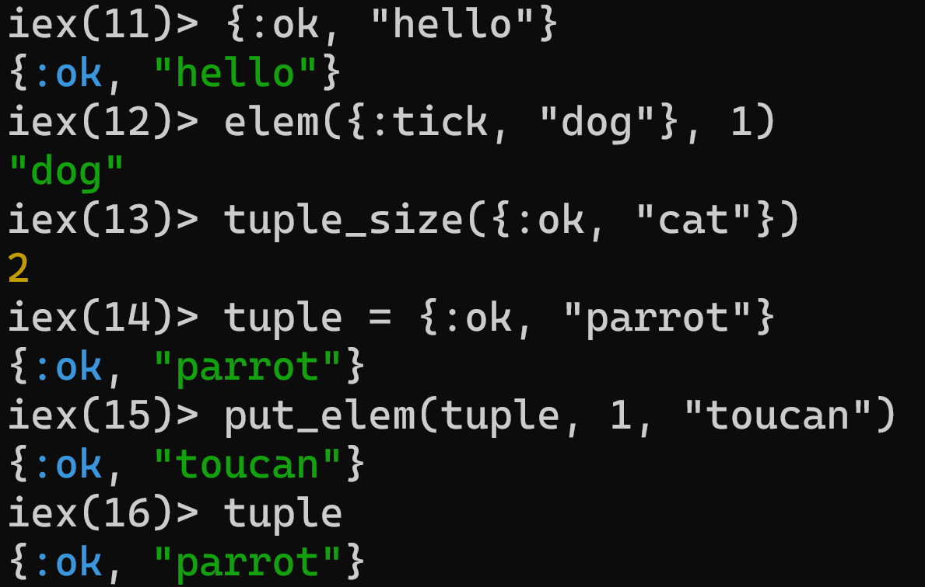
Tuples
Tuple not changed
Notes:
Tuples are ordered collections of values They use curly brackets compared to the square brackets of lists. Typically, they contain 2-4 elements. Any more than that and you should consider using a map instead.
You can get a specific element from the tuple by 0-based index using elem. You can get their size with tuple_size. put_elem returns a new tuple with the element at the given index changed. Notice that the original tuple is not changed. Remember that Elixir is immutable. There is never a question about if the inputs to a function are modified. They never are.

Slide 17
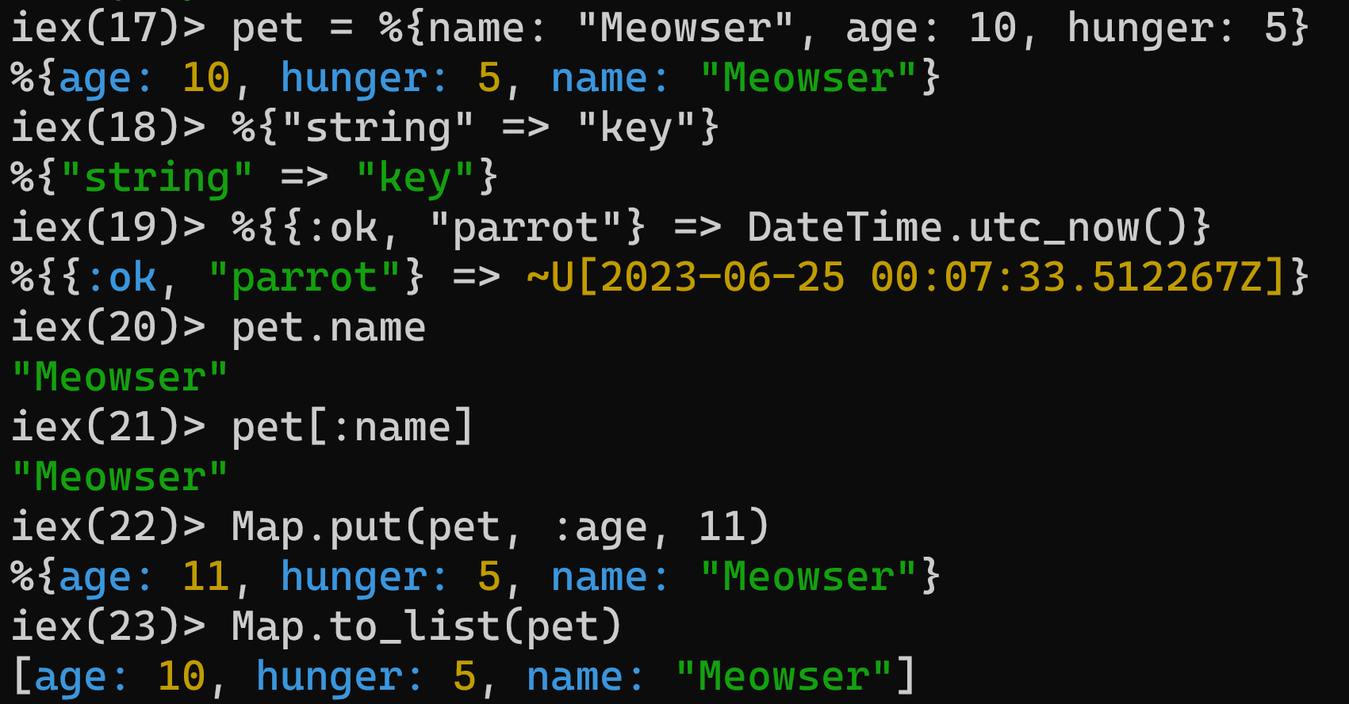
Maps
Atom key
Dot syntax
Pet not changed
Notes:
Maps are collections of key/value pairs. Keys can be different types, although you probably don't want to mix them within a map. Here you can see some examples of string, atom, and tuple keys. If the key is an atom, you can use the simpler syntax you see in the first example. In practice, your keys are going to be mostly atoms, followed strings.
If the key is an atom, you can access it using the dot syntax. Anything else should be accessed inside square brackets. And finally, Map.put is one way to update a map. You can see in the next call to Map.to_list that the original map was not modified. The age is still 10.

Slide 18
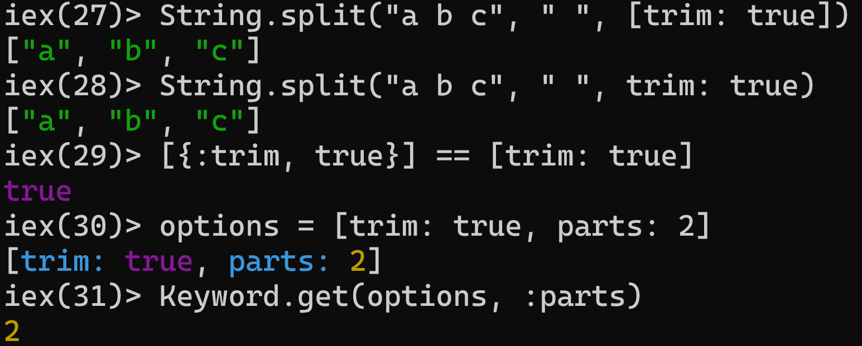
Keyword Lists
Notes:
The simpler syntax we saw when the map key is an atom, looks a lot like our next type, keyword lists. Keyword lists are often used to pass options to functions. They are a list of key/value pairs. If the last argument to a function is a keyword list, you can drop the brackets.
Each element is actually a 2-item tuple where the first element is an atom and the second can be any value.
Keys must be atoms.
Keys are ordered, as specified by the developer.
Keys can be given more than once.
Keyword lists are most often used for options to functions. In practice, that means you use them all the time, but don’t really think about them.

Slide 19
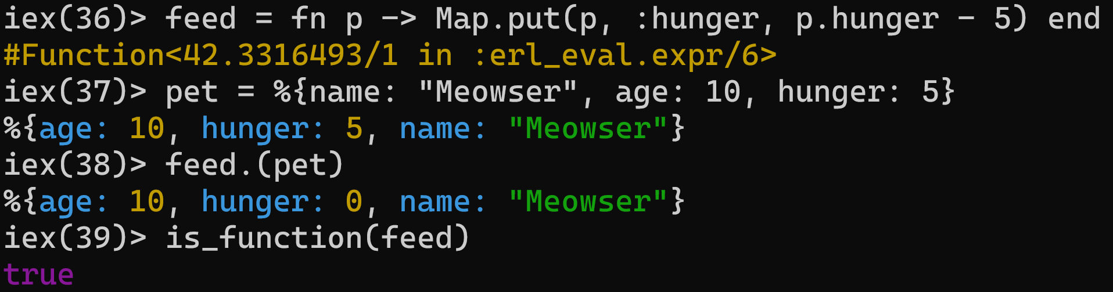
Anonymous Functions
Notes:
Finally, Elixir is a functional language, so anonymous functions are also a type. You can define them with the fn/end syntax and call them with `.`.
Here, Meowser is feeling pretty hungry, so we define an anonymous function to feed them.

Slide 20
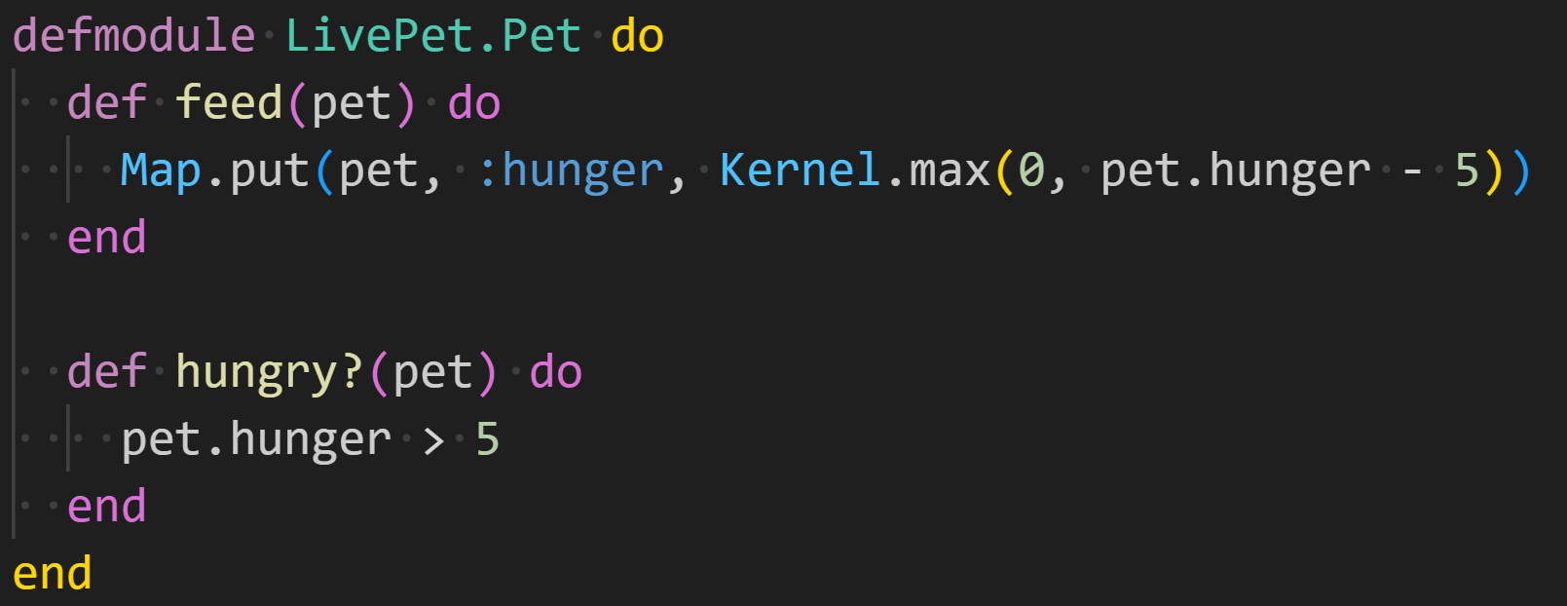
Modules & Functions
Notes:
Modules in Elixir are a way to group together functions. Public functions in a module are defined with “def” and private functions with “defp”. You’ll often see function definitions referred to as feed/1, where the one is the number of arguments to the function.
This example has an issue though. We’re just assuming that “pet” is a map with a hunger key. We can do better than that though.

Slide 21
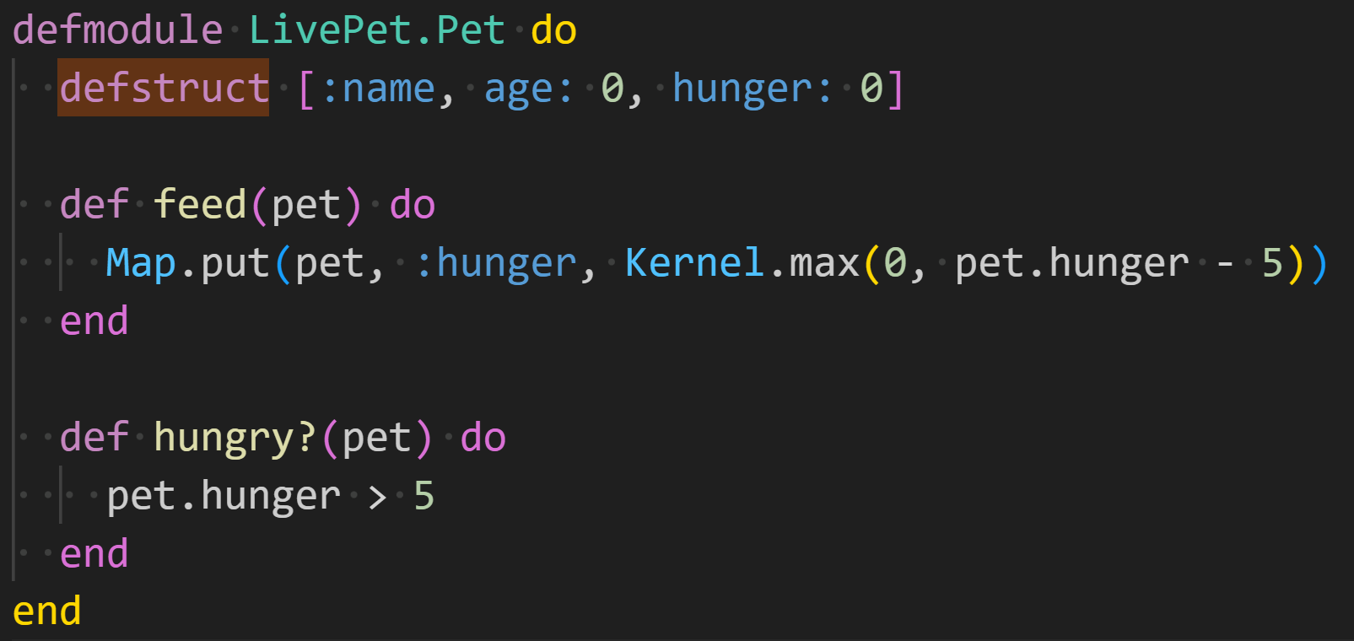
Structs
Notes:
One way we can do better is with structs. Structs are defined in a module and have the same name as the module. So, adding on to the previous example, we can define a struct in the module like this. This creates a “Pet” struct that has a name, age, and hunger. Age and hunger default to zero.

Slide 22
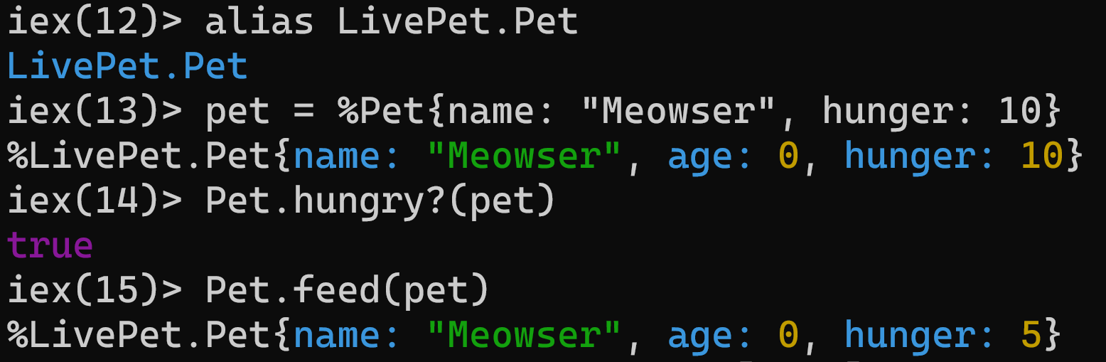
Structs
Notes:
To use the struct, we first alias it. This is just for convenience, so we don’t have to use the full module name every time we use it.
Then create a pet struct. It’s just like a map with atom keys, except we put the name of the struct after the % sign. Under the hood, structs are just maps with some additional metadata, so we can still use the feed function.
Our module still has an issue though. We’re not doing anything to check if the argument being passed in has a hunger field. Let’s fix that.

Slide 23
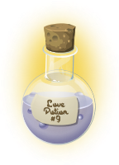
Notes:
I remember the moment I fell in love with Elixir.
It was at CodeMash 2017 when I saw a talk on implementing a binary protocol. They parsed the first bytes of a stream to extract some metadata. And they did it with zero conditional statements or branches. No ifs. No cases. No while loops. Just pattern matching.
It was as if I was bathed in the warm glow of enlightenment. So, if you’re going to walk away with anything from today’s talk, it’s this: pattern matching is awesome when the entire ecosystem is built around it.

Slide 24
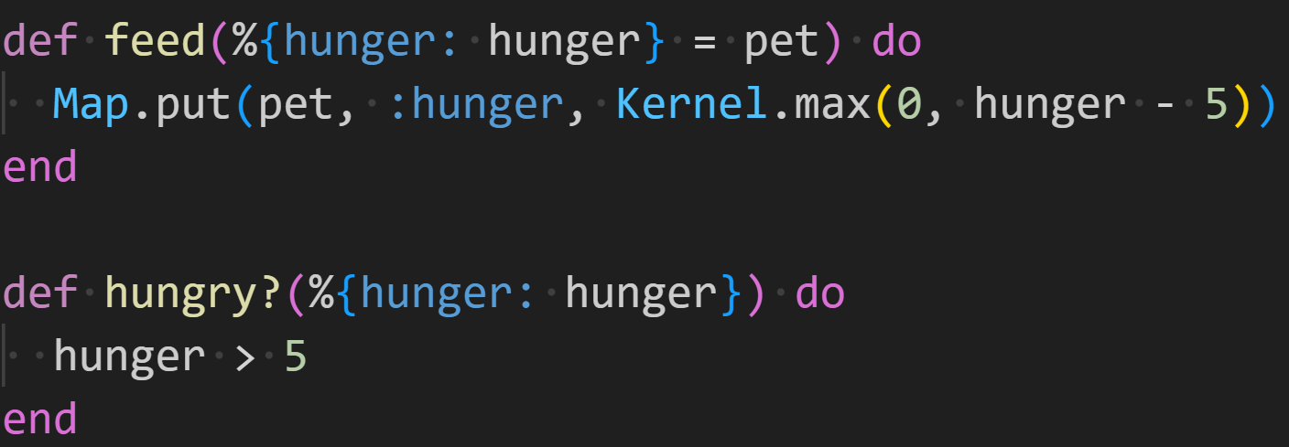
Pattern Matching
Notes:
So, let’s add a very simple pattern match to the feed and hungry? functions for our pet. This can be intimidating to read at first, so let’s walk through it.
In each function head, we’re defining the shape of a map that contains a hunger key. We assign the value of that key to the hunger variable. In feed, we also assign the entire map to the variable pet. Since structs are actually maps with some additional metadata, this pattern match means we can pass in a struct that contains a hunger jet or we can pass in a plain map with a hunger key.

Slide 25
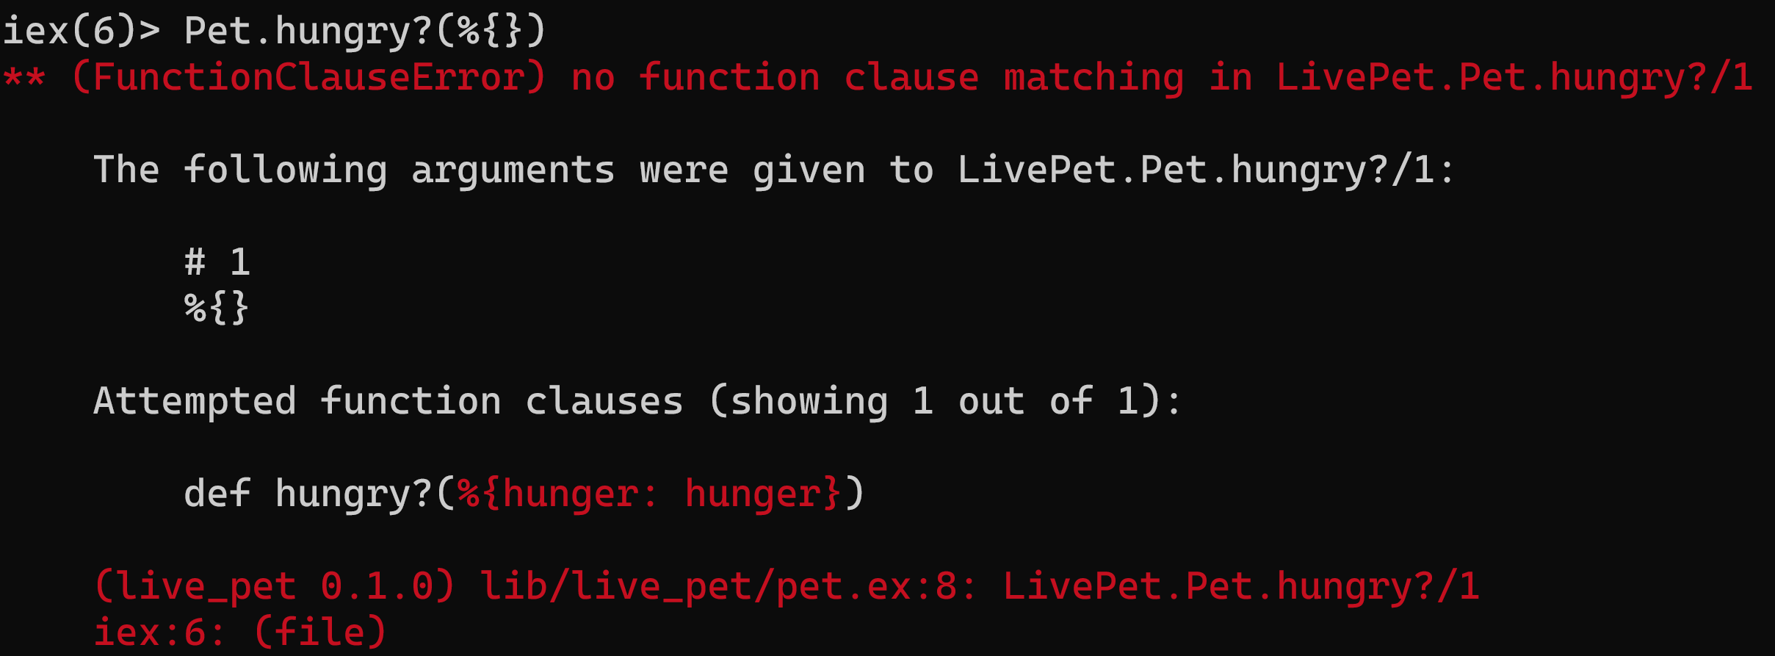
Pattern Matching
Notes:
What happens if we call this function with invalid data? We get a FunctionClauseError. Remember though, Elixir is dynamically typed, so this is all happening at run-time. There are tools to try and catch these sorts of issues at compile-time, but they are external. They are not part of the language itself.

Slide 26

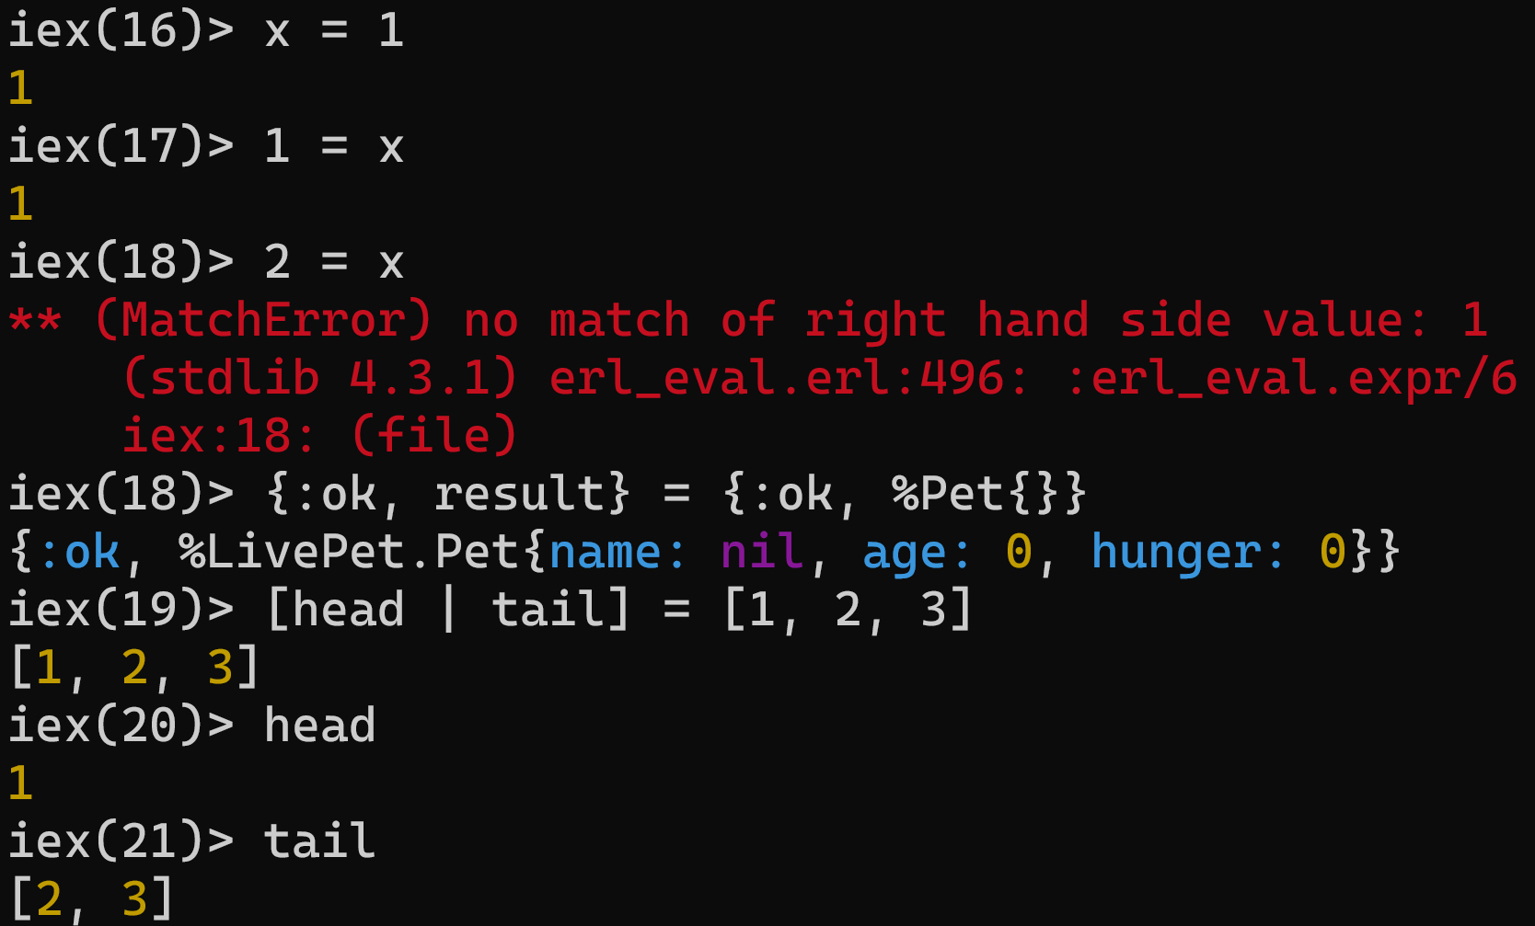

Match Operator
Notes:
Pattern matching is intrinsic to the language. So much so, that what we think of as assignment is actually a match operator. Variables on the left side of the match can be assigned to.
Can the variable x be pattern matched to 1? Sure can.
Can 1 be pattern matched to x? Sure can. X is 1 now
Can 2 be pattern matched to x though? Nope. X = 1, so there is no match.
And you can do this with tuples and lists as well. If you’ve done destructuring in other languages, it’s kind of similar, but way more powerful.

Slide 27
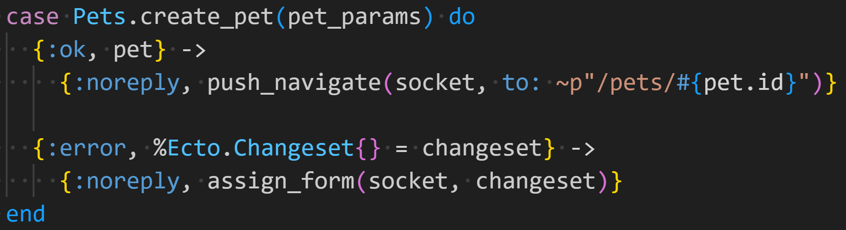
Case Statement
Notes:
There are a number of extremely common pattern match usages outside of function definitions. The case statement is one of them.
In Elixir, an idiomatic pattern is to return tuples from functions that can have expected errors. The first element is either :ok or :error. Here we call Pets.create_pet. If the input does not pass validation, then we get back the 2-tuple with :error and an Ecto changeset. Ecto is a library for data mapping and language integrated queries. A changeset describes what changes to apply and will include information about validation errors.
Case is highly preferred over if in Elixir. As a general rule, if you find yourself using an if statement for more than a simple true/false check, ask yourself if you need to be. Could you be doing something with multiple function heads or a case statement instead?

Slide 28
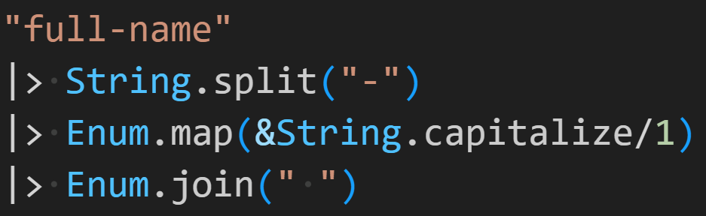
Pipelines
[“full”, “name”]
[“Full”, “Name”]
“Full Name”
Notes:
We’ve all done this. Who feels terrible every time they do it?
Pipelines are second in my heart to pattern matching. Pipelines take the result from the previous expression and pass it implicitly as the first argument to the next function in the pipeline.
This example starts with a string. Since we’re using the pipeline operator, “full-name” gets passed as the first param to String.split. That gives us a list with two elements, which gets passed to Enum.map as the first param. Enum.map runs String.capitalize on each element and returns a new list. Finally, that list gets passed to Enum.join and it spits out “Full Name”
Anybody here created fluent interfaces in an object-oriented language? I used to do the same thing in C# all the time for data transformation pipelines. Elixir pipelines are way simpler to use. They are baked into the entire ecosystem. Everybody expects to be able to easily use your library as part of a pipeline.

Slide 29
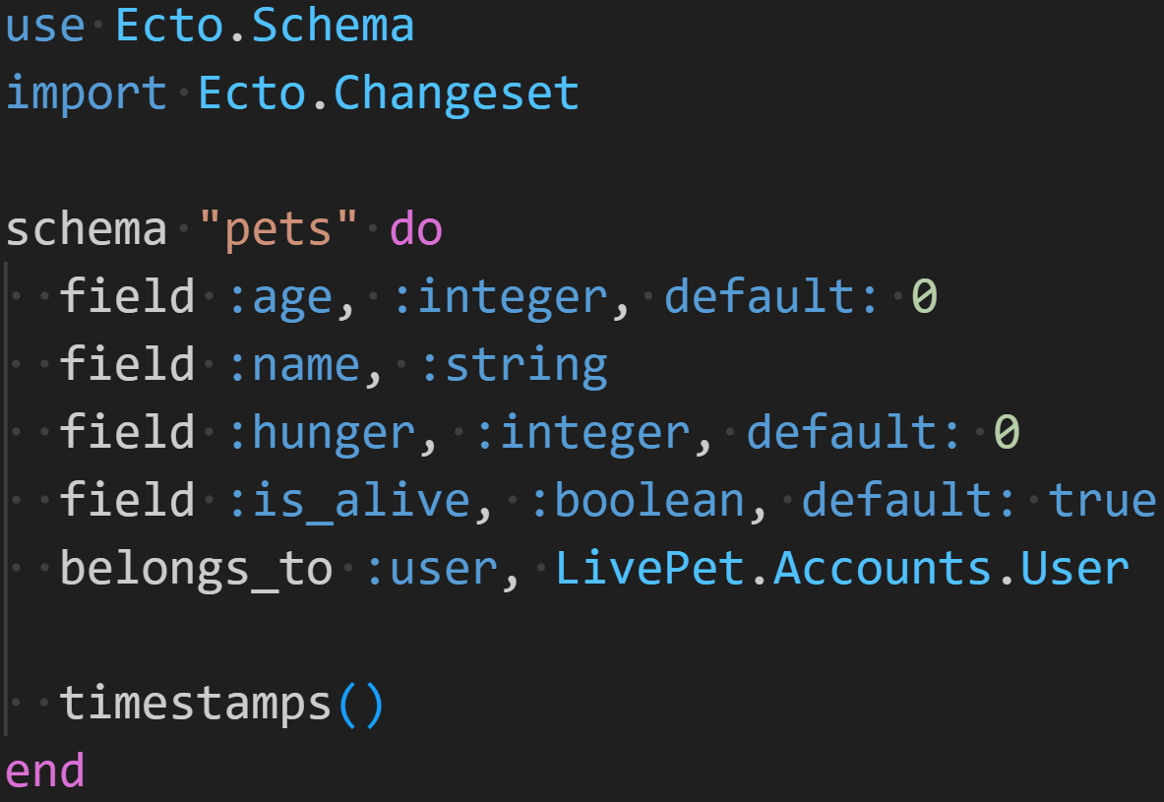
Macros
Notes:
The final Elixir language feature I want to mention is macros. Macros are a huge part of the Elixir ecosystem. They are so interwoven into the fabric of the language and libraries that you often don't even have to be aware that you're using them. Macros run at compile-time. The are essentially code that writes code. This is commonly called metaprogramming. Elixir uses it to shift work from run-time to compile-time and to provide DSLs for common use cases.
In this example we’re defining the schema for the pets table. Use is a keyword that will run macros in the Ecto.Schema module to inject code into the current module. Schema is a macro. Field is a macro. Belongs_to? Macro. When you see code that doesn’t look a function definition in a module, there is a good chance that macros are involved.
A huge chunk of your day-to-day work in Elixir involves using macros. The surface area of the Elixir language is very small. You won’t write too many of them yourself, but they’re all over the place in framework code.

Slide 30
Agenda
Elixir Crash Course
Processes & Concurrency
LiveViews
Events
Real-Time Updates
Components
Presence
PubSub
Notes:
That was a lot. Don’t worry. If you’re used to JavaScript, C#, Java, or another similar, popular language, Elixir may just look weird to you. I promise it looks less weird with time.
Let’s move on to our next topic, processes and concurrency.

Slide 31
The Actor Model
In the Erlang VM, all code runs in tiny concurrent processes, each with its own state. Processes talk to each other via messages. And since all communication happens by message-passing, exchanging messages between different machines on the same network is handled transparently by the VM, making it a perfect environment for building distributed software.
- José Valim - Programming Elixir foreword
Notes:
Anybody know what kind of programming model this represents? Lots of tiny concurrent processes, each with their own state, passing messages back and forth with each other?
It's the actor model.
And the BEAM, the virtual machine, implements the actor model. Let’s look at what that means in practice.

Slide 32
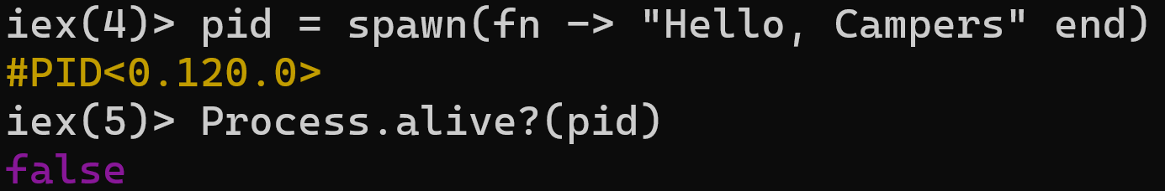
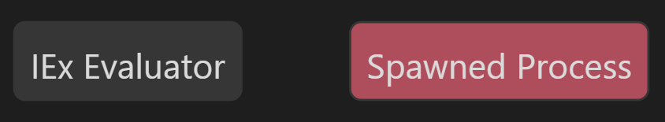
Spawning Processes
Notes:
At a very low level, you start a new process with `spawn`. It takes a function that it will execute in another process. It returns a process identifier, abbreviated as PID. The process immediately starts executing. And we can see that it is no longer alive when we check right after spawning it.
The state of each process is completely isolated. The process we spawned cannot modify any state in its parent and vice-versa. They can execute concurrently without any worries about trampling each other’s state.

Slide 33
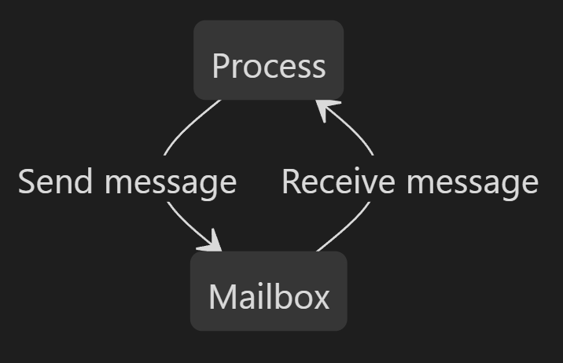
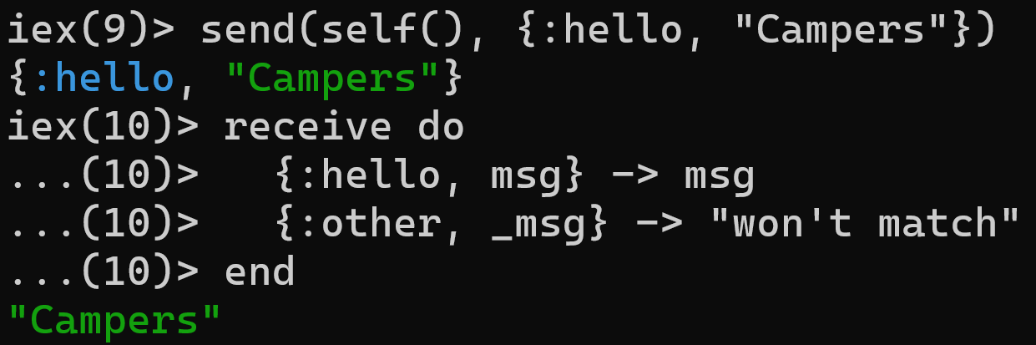
Messages
Send to myself
Pattern matching!
Notes:
We can send messages to a process with `send` and receive them with `receive`. Every process has a mailbox that stores messages it receives. `receive` blocks while waiting for a message to be in the mailbox. You can see that choosing how to handle a message is just another usage of pattern matching. We pattern match on the message itself to choose what to do.
The message just sits in the process’s mailbox until receive is called. self() gets the PID of the current process. That means that this process is sending a message to itself. This is a pretty common pattern.

Slide 34
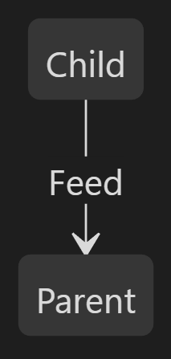
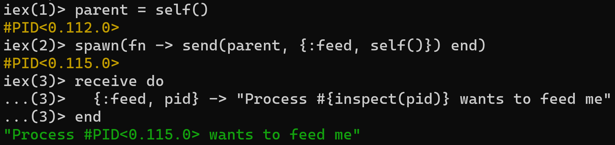
Inter-process Communication
Child process sends
message to parent
Notes:
Inter-process communication is similar. Once again, we spawn a process, but this time the new process is going to send a feed message back to its parent. The parent will receive that message and return the string.

Slide 35
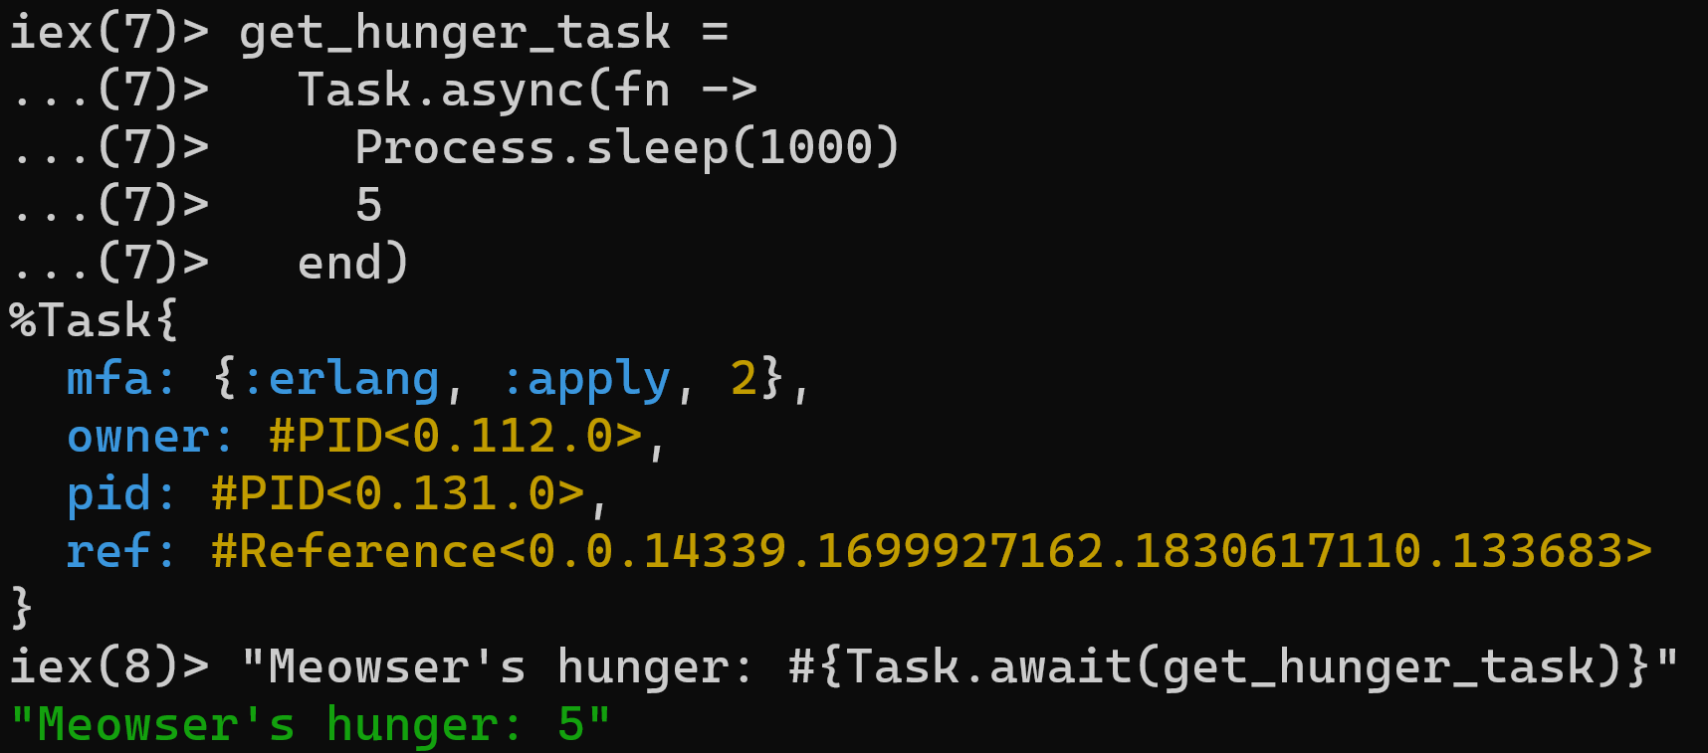
Tasks
Notes:
In practice though, you’re not going to be directly spawning processes and receiving messages that way. The lowest level of abstraction that you’re likely to use is a Task. Tasks build on top of spawn to provide better error reports and introspection.
In this example, we start an aysnc task that is just going to sleep one second and then return 5. Since this task is a separate process, the current process won’t be blocked. Then we await the task and print out how hungry our friend “Meowser” is.

Slide 36
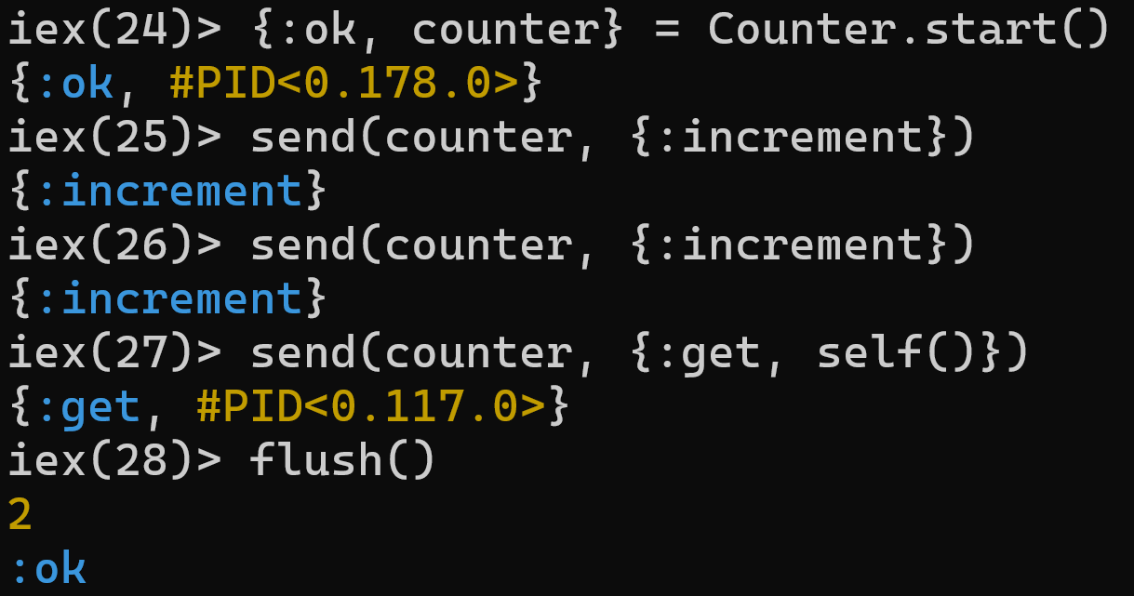
Managing State: Counter
defmodule Counter do
def start do
Task.start(fn -> loop(0) end)
end
defp loop(count) do
receive do
{:increment} ->
loop(count + 1)
{:get, caller} ->
send(caller, count)
loop(count)
end
end
end
Receive another
Notes:
Elixir is functional. There are no objects to manage state for us, but we still need to manage it somehow. This is one of the big use cases for processes.
On the left is a module that defines a simple counter. When we start it, we start a loop that just processes messages. An increment message updates the counter and a get message returns the value to the caller.
On the right, you can see an example of starting a Counter process and sending it some messages. The flush() function at the end just flushes all messages out of the current processes mailbox. We called increment twice and then get, so 2 gets flushed out of the mailbox and then an :ok saying that the flush succeeded

Slide 37
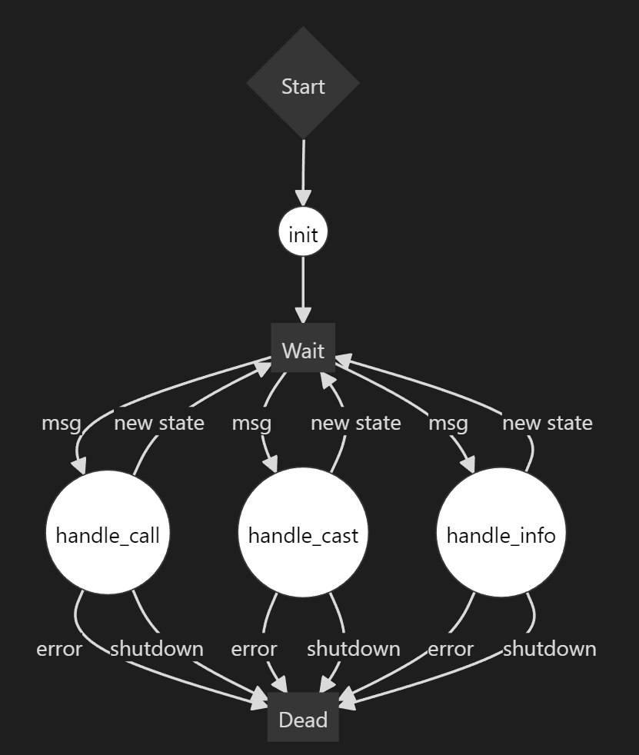
GenServer
Notes:
Now you've seen how to spawn new processes, send messages, and process them at a very low level. But in Elixir, you don't actually build applications at this low level. Instead, we use GenServers.
GenServer stands for *Generic Server* and it provides a standard set of functionality for processes. You just implement some callbacks. The most common ones are in this diagram: init, handle_call, handle_cast, and handle_info.
You start the GenServer, the init callback gets called, and then it starts waiting for messages
handle_call is synchronous. It blocks on the caller and returns a value.
handle_cast is fire and forget. It returns nothing to the caller.
We’ll talk about handle_info later.

Slide 38
GenServer: Counter
defmodule Counter do
use GenServer
# Client
def start_link() do
GenServer.start_link(__MODULE__, 0)
end
def increment(pid) do
GenServer.cast(pid, :increment)
end
def get(pid) do
GenServer.call(pid, :get)
end
# Server (callbacks)
@impl true
def init(count) do
{:ok, count}
end
@impl true
def handle_cast(:increment, count) do
{:noreply, count + 1}
end
@impl true
def handle_call(:get, _from, count) do
{:reply, count, count}
end
end
New state
Return value
Notes:
Here is the same counter example, but written as a GenServer. On the left is the client-side interface of the module. This is what consumers will actually call. It’s the same increment and decrement that we had before.
On the right are the GenServer callbacks. Both handle_cast and handle_call set a new state, but only handle_call returns a value to the caller.

Slide 39
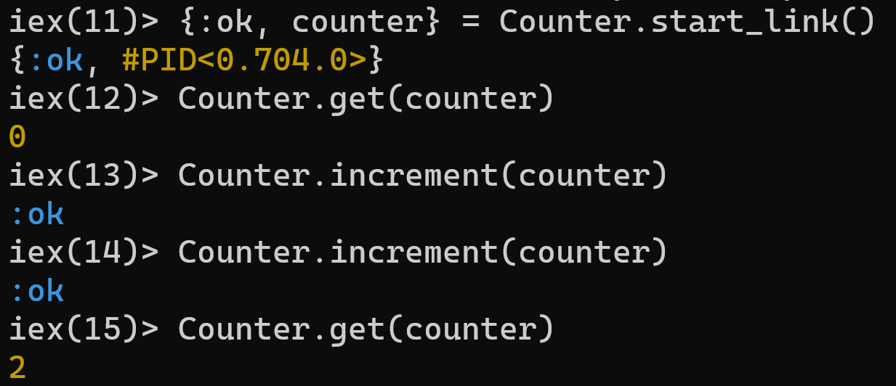
GenServer Usage
Notes:
And this is how you call it. Notice how the fact that this is a separate process is completely abstracted away from the caller. In Elixir, you’re going to be using GenServers all the time when you use various libraries and frameworks. That is almost always completely abstracted away from you though.

Slide 40
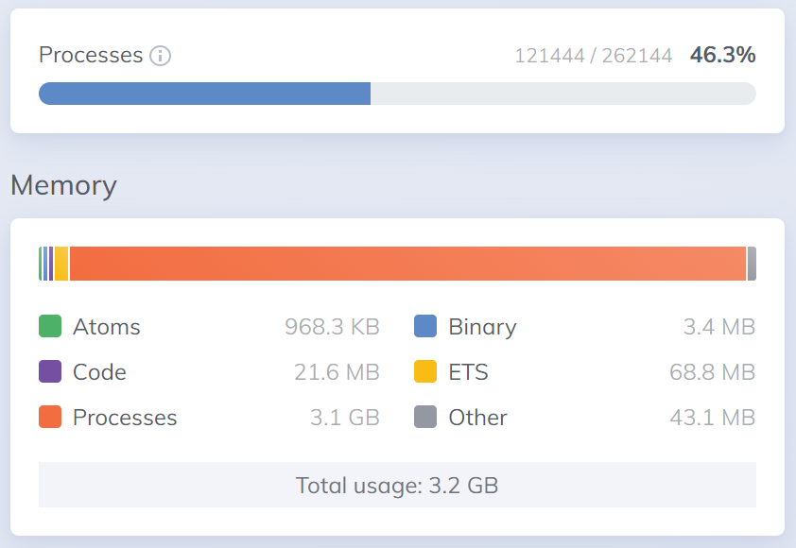
Scalability
Notes:
BEAM processes are not operating system processes. The overhead of creating a new process is a few KB. This is considerably more lightweight than threads *and* we get the benefits of isolation. You can run hundreds of thousands of these without issue in a production environment.
Out of curiosity, I wanted to see how many pets I could simulate simultaneously. I stopped at 120,000. You can see that this used 3.2GB of memory. My CPU was pegged ~30% on a pretty beefy machine.
And these processes can be distributed. We're not going to go over any of that today, but you can orchestrate across an entire cluster of nodes. The BEAM handles the details of all the communication for you. You don't have to care what node a particular process is running on at all.

Slide 41

Supervision Trees
Socotra Dragon Tree
Notes:
Every Elixir application is a tree of processes. A supervisor is a process that manages other processes.
Elixir has a philosophy of "let it crash". When a process enters an unexpected state, rather than try to recover, just let it crash. The supervisor is responsible for starting it again.

Slide 42
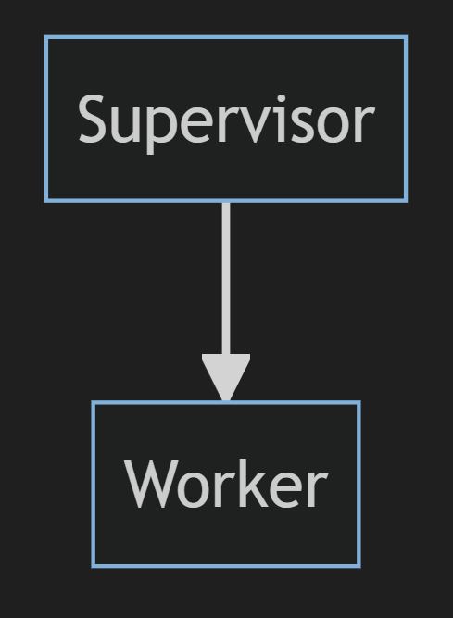
Supervising One Worker
Notes:
You can have a supervisor supervising just one worker. If that worker crashes, the supervisor will restart it.

Slide 43
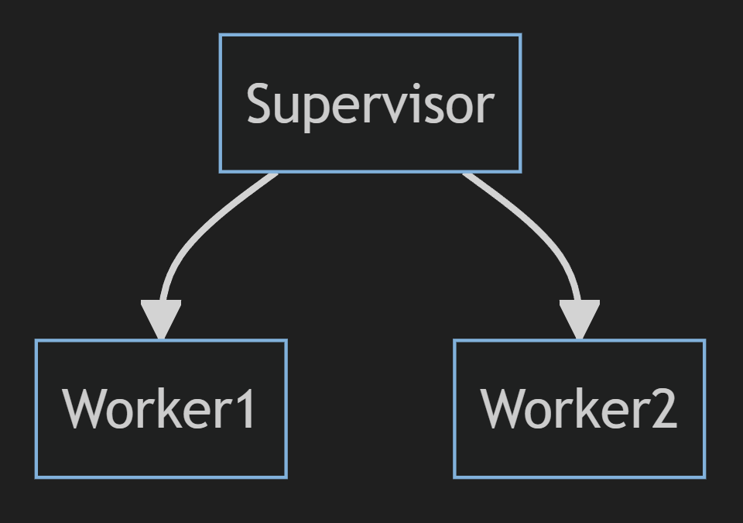
Supervising Multiple Workers
Notes:
Or your supervisor could supervise multiple workers. This is the case in LivePet, where there is a single supervisor for every pet simulation process.

Slide 44
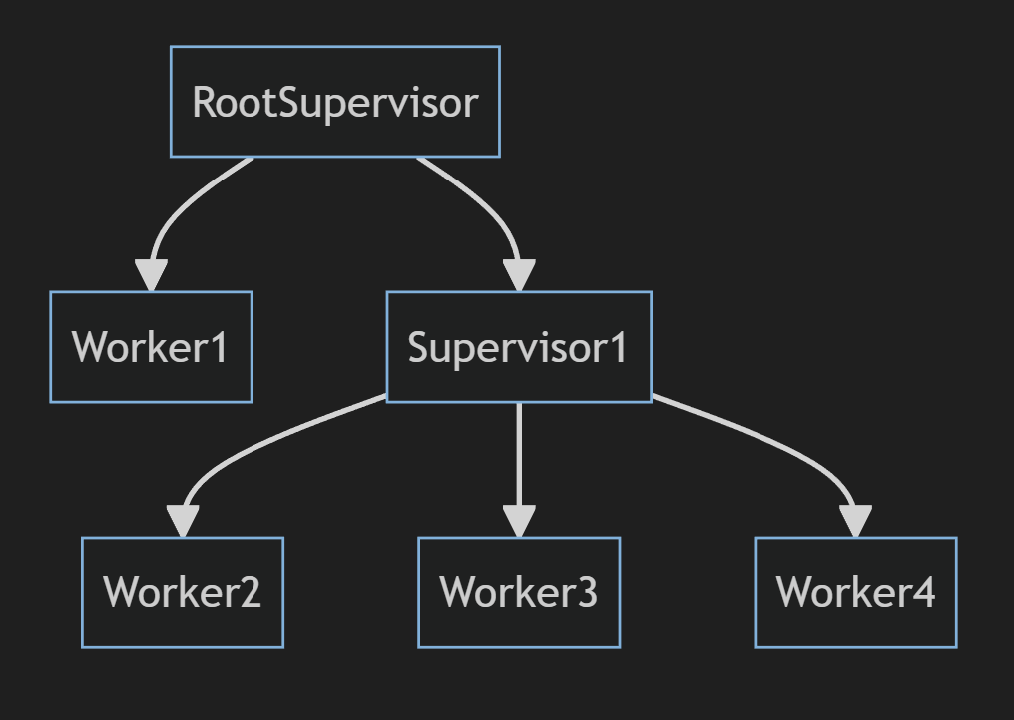
Supervision Tree
Notes:
And since supervisors themselves are just processes, applications end up structured as supervision trees. Supervisors of supersivors with worker processes of some sort as the leaf nodes.

Slide 45

Demo
Notes:
Let's look at the supervision tree that gets started when we start up LivePet. Most of this is boilerplate that is generated with the app. You can see telemetry is a separate process. Ecto, which controls our DB communication, is a separate process. Finch is an HTTP client. Separate process. The endpoints for our app? A separate process. And, in reality, these are all supervisors themselves. As the consumer though, you don't have to care. You just start a child process. The fact that the child process itself is a supervisor is an implementation detail.
There are different kinds of supervisors as well. In the previous example, you saw we just started a `Supervisor`. That takes in a list of children when started. You can't add anything to it after it starts. But we're running a dynamic number of pets, so we're going to reach for a `DynamicSupervisor`. Let's look at `LivePet.PetInitSupervisor` to see how that works.
You can't pass a list of children to a `DynamicSupervisor` when it starts, but what we can do is start a separate process, a `Task` in this case, that will start all the pets. We load them all from the DB and start a child process of the `DynamicSupervisor` for each pet. And since those pet processes run under the supervisor, if anything goes wrong, we'll start the process again automatically. Fault tolerance!

Slide 46
Agenda
Elixir Crash Course
Processes & Concurrency
LiveViews
Events
Real-Time Updates
Components
Presence
PubSub
Notes:
That wraps up our whirlwind tour of Elixir the language and the process model. The process model is the foundation for how any Elixir app works, including a LiveView app.
Let’s move onto LiveView itself.

Slide 47

Phoenix
Notes:
Phoenix is the dominant web framework in the Elixir ecosystem. It roughly follows the MVC pattern. If you have experience with any other server-side MVC framework, the core principles will look pretty familiar to you.

Slide 48

https://survey.stackoverflow.co/2023
Notes:
This is the same kind of desired and admired chart we saw earlier for Elixir, but this time for Phoenix. You can see that people really like ASP.NET Core, Svelte, and Solid.js. But out in front is Phoenix, the dominant web framework in the Elixir ecosystem. So, Elixir is the second more admired language and has the most admired web framework.

Slide 49
Context switching is not
JavaScript is fine
Notes:
I don’t mind modern JavaScript on the front end. I think it’s a reasonable language now. For years it was the only option on the front end.
But context switching is not. And eliminating context switching between languages was one of the big reasons we started using JavaScript on the back end to begin with. But, in my opinion, there are much better languages to be using on the back end. And now there are tools that help eliminate the context switching by letting you write your back end language of choice for complex web apps.

Slide 50
LiveView
“A LiveView is a process that receives events, updates its state, and renders updates to a page as diffs.”
- Phoenix.LiveView Documentation
Notes:
LiveView builds on top of Phoenix to provide this to the Elixir ecosystem.
When you go to a LiveView page, a process is started receives events, updates its state, and renders updates to a page as diffs. I really want to stress that a LiveView is just another process.

Slide 51
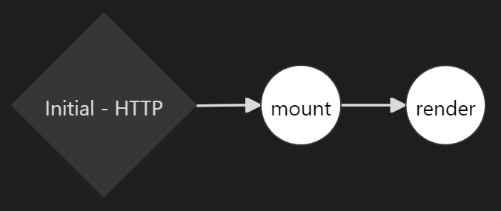
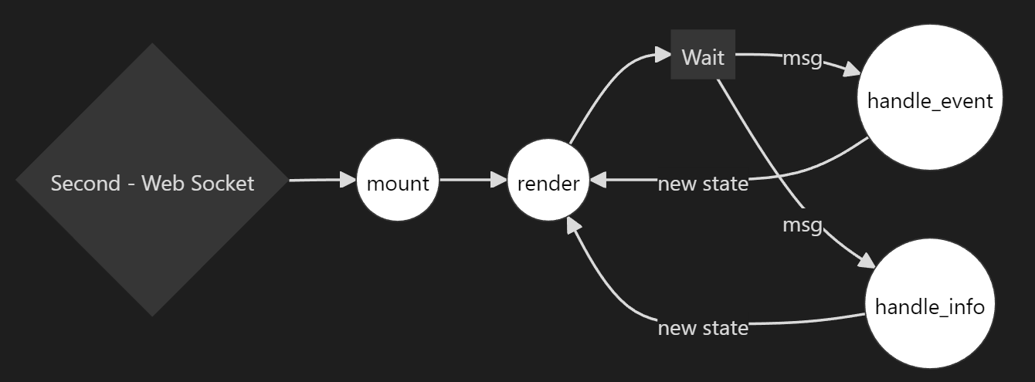
LiveView Lifecycle
Initial GET request
From client over web socket
From other process
Web Socket
Notes:
This is the live view lifecycle. The initial GET request calls a function called mount to get the state to render, then the template is rendered, and the response returned to the client.
After the client renders the response in the browser, it opens a web socket connection back to the server. Mount and render get called again. A diff gets sent back to the client over the web socket with any changes to the HTML. From there, it’s just a process. It consumes handle_event messages from the client that get delivered over the web socket, makes state changes, and renders a new state to send the HTML diff back to be applied.
And since it’s just a process, it can consume messages from other sources too with handle_info. That could be something running in your system, like a simulated pet. Or it could be a 3rd party API. Or an IoT device. If you can send a message to the live view process, you can update the state and render changes for the user from any source.

Slide 52
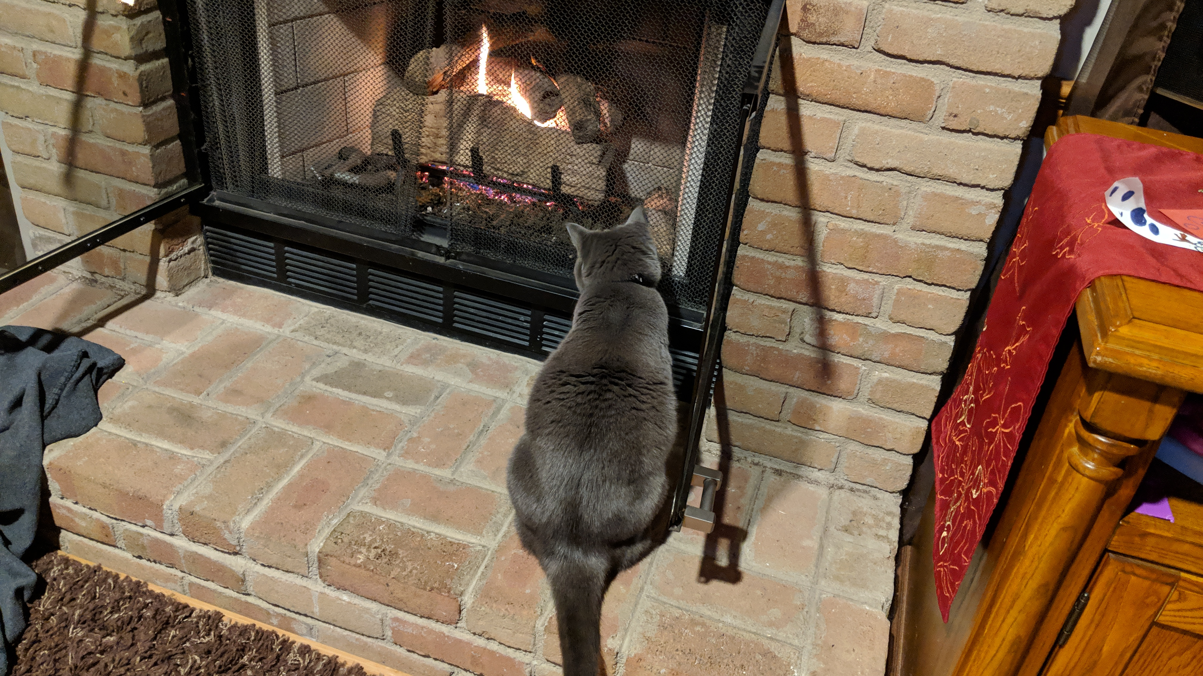
Demos
Notes:
With that, let’s start diving into some code for THAT Pet.

Slide 53
Agenda
Elixir Crash Course
Processes & Concurrency
LiveViews
Events
Real-Time Updates
Components
Presence
PubSub
Notes:
We just went over a lot. We looked at several different live views for creating a pet, listing pets, and viewing pets. We saw how we could handle events from the browser. We saw how we can get real-time updates by handling messages from the pet simulation. We saw both function and live components. And we wrapped up by looking a little bit of presence and pub-sub.

Slide 54
Resources
Elixir in Action (book)
Programming Phoenix LiveView (book)
Dave Thomas: Elixir for Programmers 2 (video course)
https://elixir-lang.slack.com
https://elixirforum.com
https://livebook.dev/
Website
https://brianmeeker.me
GitHub
https://github.com/CuriousCurmudgeon/live_pet
Mastodon
@brianmeeker@hachyderm.io
Notes:
I love Elixir. It’s my favorite programming language right now. I spent the previous decade almost exclusively as a C# dev. Switching to Elixir has been fantastic. It’s reinvigorated my love for programming. Every time I write a GenServer, it feels like I have a new super power.
I’ve added all of these resources, including the link to the GitHub repo, to the session page on the website. I’ll add the slides to GitHub shortly after the talk as well.
LiveView itself is very close to a 1.0 release. They’ve been very cautious with calling it 1.0, but they’re close to doing so. It’s very full featured already and we use it production at Online Rewards without issue.

Slide 55


Notes:
Session feedback is greatly appreciated. This QR code will take you to the survey form for this session.
Once again, I am Brian Meeker. It has been an honor to present to you today. If you have any questions or want to chat, come on up. Enjoy the rest of your week at THAT Conference and create some pets if you feel like it

Slide 56
Thank You
Website: https://brianmeeker.me
GitHub: https://github.com/CuriousCurmudgeon/
Mastodon: @brianmeeker@hachyderm.io

